Slide 1
Annamacharya institute of technology and sciences,tirupati
Summer internship 2k19 Project presentation

Slide 2
By team unbeatables
Team Members:
P.Utkarsh
G.Yamini
T.Virajitha

Slide 3
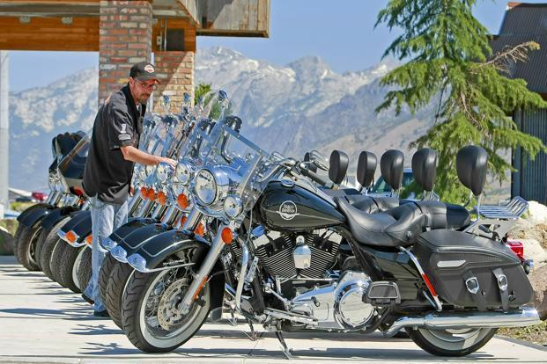
Bike Buyer Prediction

Slide 4
Plan of presentation
Introduction
Project Description
Dataset Explanation
Model Explanation
Accuracy
Pros and Cons of the Model
Conclusion

Slide 5
Introduction
Machine Learning :
Machine learning is the scientific study of algorithms and statistical models that computer systems use in order to perform a specific task effectively without using explicit instructions, relying on patterns and inference instead. It is seen as a subset of artificial intelligence.
Python in ML :
Python community has developed many modules to help programmers implement machine learning. In this project, we will be using numpy,pandas and scikit-learn modules.

Slide 6
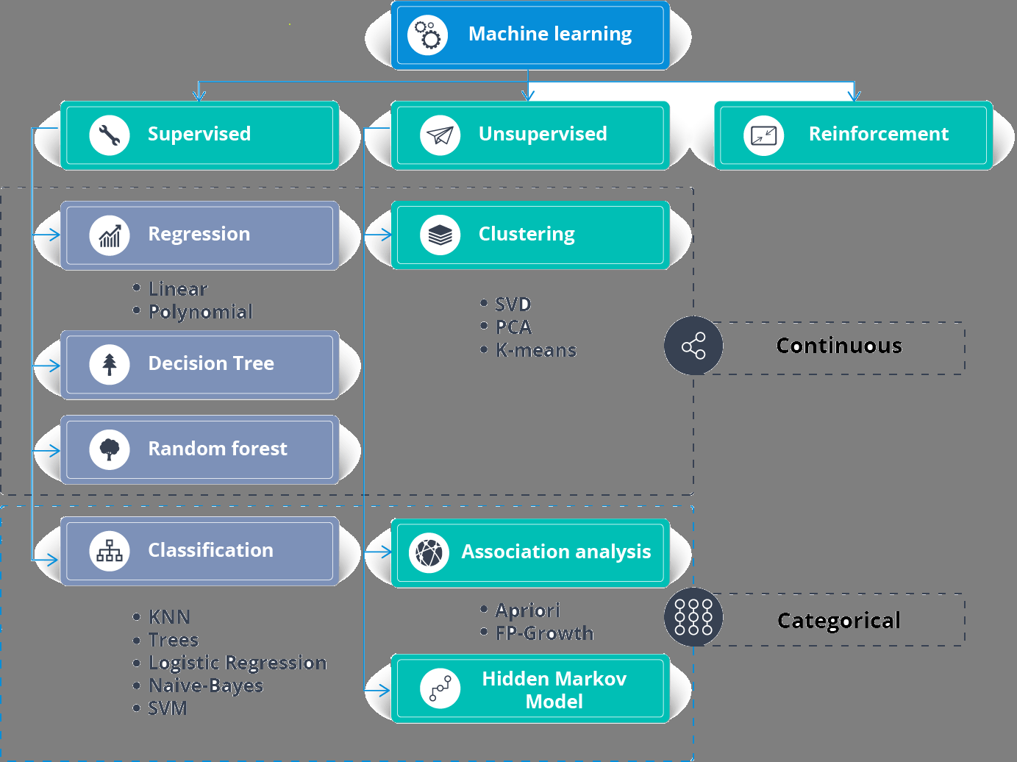

Slide 7
Project Description
Bikes are the affordable vehicles for all kinds of people. As the need of transportation increases the usage of bikes also increased which results in the sudden rise of automobile industries. The automotive industry continues to face set of challenges. Most manufacturing operations in automotive industries are still largely dependent on experiences-based human decisions. I am highly interested to apply Machine Learning in the automotive industry to make a remarkable ability to bring out hidden relationships among datasets and make predictions.
The problem with every manufacturing company is about the amount of production of the product. If they couldn’t understand the requirement of the product before manufacturing it results in the incurring of losses to the companies. In this project we focused on automobile industry in which bikes are key roles. Our project helps the industry to predict the correct requirement of the product based on customers behavior in the previous deals.

Slide 8
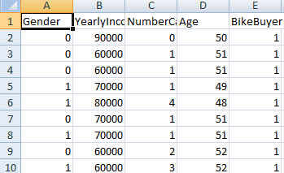
Dataset explanation
We have chosen a dataset it consists of 5 attributes and 547 rows which includes entities like Gender ,Yearly income , age ,number of cars owned , bike buyer .

Slide 9
Model explanation
As we need to predict whether a person is a bike buyer or not we do not deal with continuous values in our dependent variable, we have opted classification model for our project.
In classification we have 1.random forest
2.decision tree
3.knn
4.svm
5.logistic regression
We have chosen decision tree because of predicting high accuracy 0.69
Decision Tree Classifier The decision tree can be used to visually and explicitly represent decisions and decision making. As the name goes, it uses a treelike model of decisions. Though a commonly used tool in data mining for deriving a strategy to reach a particular goal, it’s also widely used in machine learning.

Slide 10
accuracy
When we used random forest the accuracy that we predicted is 0.6363636363636364
When we used logistic regression the accuracy that we predicted is 0.52
When we used decision tree the accuracy that we predicted is 0.6934306569343066
When we used KNN the accuracy that we predicted is 0.6058394160583942
By this we can conclude that decision tree classifier is suitable model for this model,

Slide 11
Pros and cons of the model
Pros:
1.able to handle categorical and numerical data.
2.doesn’t require much data pre-processing ,and can handle data which hasn’t been normalized , or encoded for machine learning suitability.
3.simple to understand, visualize and interpret.
Cons:
1. complex decision trees do not generalize well to the data and can result in over fitting.
2.unstable,as small variations in the data can result in a different decision tree.

Slide 12
conclusion
In this project, we have proposed methods for prediction of bike buyers using machine learning techniques. The four machine learning techniques that were used include SVM, Random Forest, Decision tree, KNN. The system was implemented using all the models and their performance was evaluated. Performance evaluation was based on certain performance metric. Decision Tree techniques resulted highest score of 0.69. From the above results Decision Tree plays a key role in shaping improved classification accuracy of a dataset.

